Slide 1
--- BASIC ---
VIDEO
PROCESSING

Slide 2
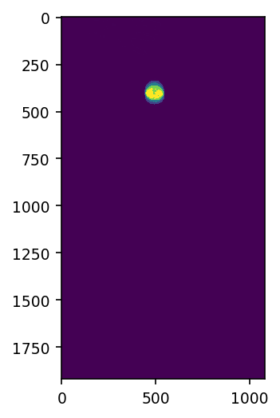
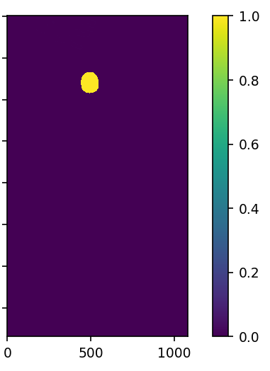
In this activity, a classical mechanics problem was solved using a video processing approach. A video capturing a free fall motion and bouncing of a rubber ball was first converted to image frames. On each frame, non-parametric segmentation with 25 histogram bins using the pink ball as the region of interest was carried out. After thresholding the resulting segmented, the image is now sufficiently “cleaned”as shown in Figure 1. From the blob analysis technique, I was able to extract the centroid coordinates and bound the object with an ellipse. Storing theses coordinates is all that we need for classical analysis. The process is visualized further in Figs. 2 & 3.
Figure 1. A sample step consisting of non-parametric segmentation (left) and thresholding (right) implemented on a single video frame. The resulting binarized image shall be used for centroid detection.

Slide 3
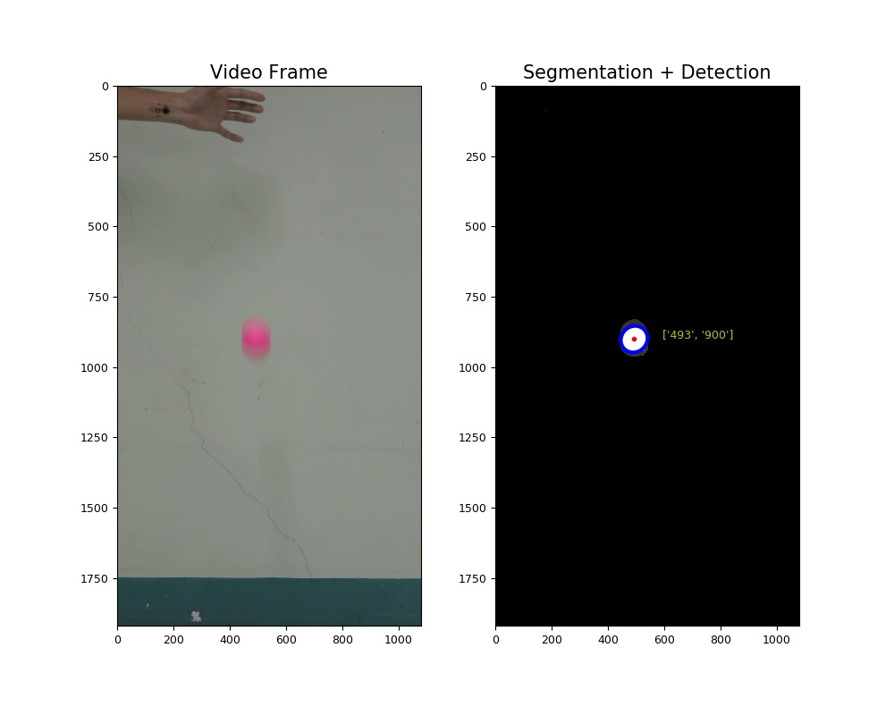
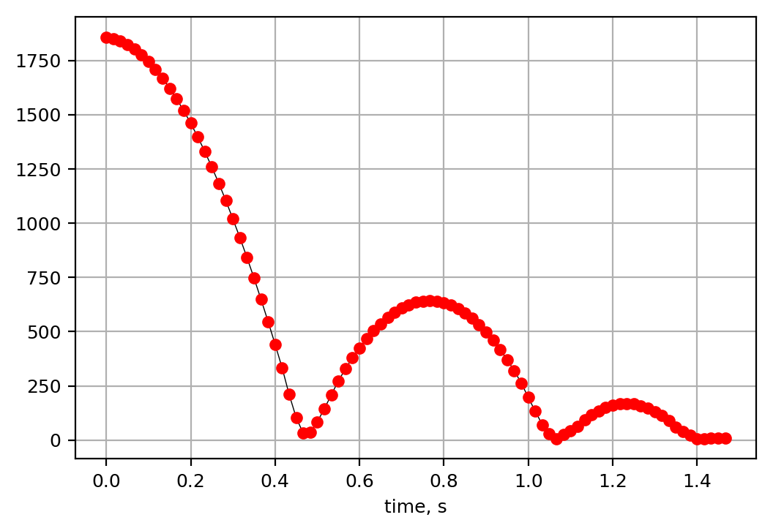
Figure 2. Video Frame 18 (left) and blob detection on the segmented image of the ball (right). Coordinates of the centroid for each image frame is stored.
Figure 3. The plot of Y-pixel values of the centroid vs time shows the free fall motion of the ball, as well as the bouncing after it hits the bottom of the frame (floor).

Slide 4
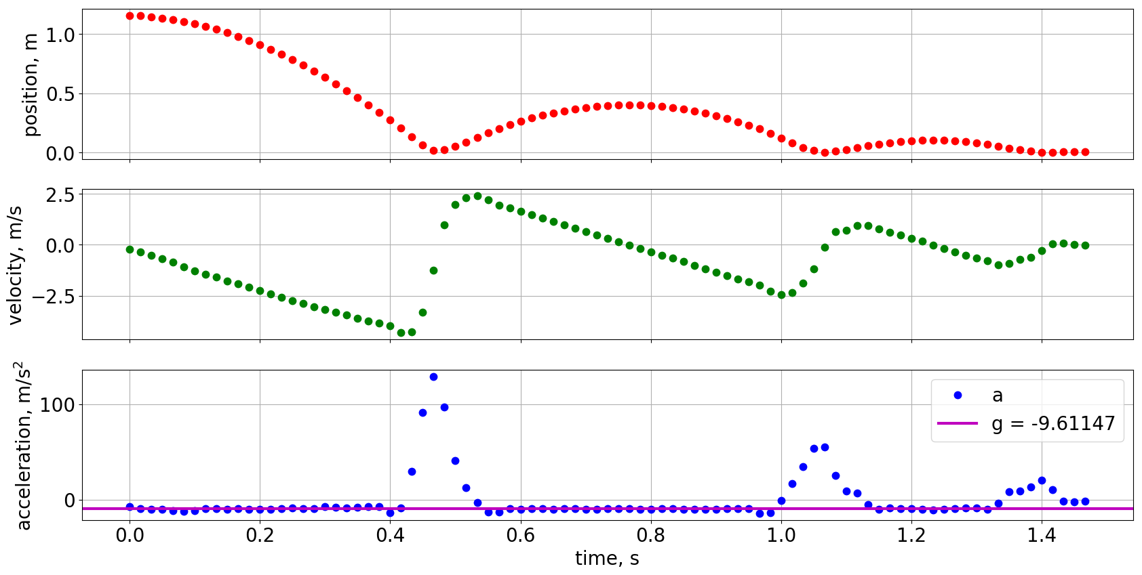
Figure 4. Y-Pixel values were converted to distance values in meters using the pixel-to-meter relation derived from the ball’s diameter in pixels. The velocity and acceleration plots were computed by taking the derivative. Experimental acceleration due to gravity turns out to be -9.61 m/s²

Slide 5
To convert pixel values to position, the pixel-to-meter relation was obtained by relating the balls diameter in meters and in pixels. It was found that 6.5 cm correspond to 104.65 pixels. Hence, the position plot was converted to meters. In Fig. 4, velocity was calculated by differentiating the time-varying position and the acceleration was taken to be the derivative of the velocity. I employed numpy.gradient for the differentiation operation. The mean acceleration for the segments when the ball was in motion is calculated to be -9.61147 m/s², around 2% error from the theoretical acceleration due to gravity. Using basic video processing, I was able to extract information necessary to solve a classical mechanics problem with high accuracy.
I want to thank Kenneth Domingo for gathering the data (video) with me and helping me with some technicalities in my coding.
In this activity, I’d give myself a 10.
References:
[1] M. Soriano, Basic Video Processing, (2019).

Slide 6
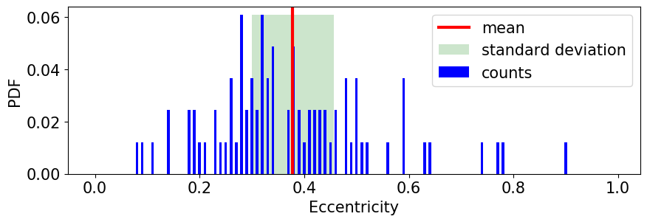
Figure 9. Probability distribution function and statistical properties of the blob eccentricity.
To sum up, I was able to apply segmentation and morphological cleaning on the cellular image and compared their effect on blob detection algorithms. Statistical analysis was also carried out to get an estimate of the blob’s features and the probability distribution function for each feature was plotted for visualization. I wanted to compare the calculated feature measurements to the actual cell’s feature measurements however, a scale isn’t present in the test image.
Nevertheless, blob analysis was successfully carried out using image processing techniques and for this, I give myself a 10.
I want to thank Kenneth Domingo for helping me understand the step sequence in this activity, and for recommending that I should try out Skimage’s blob detection algorithm
References:
[1] M. Soriano, “Blob Analysis,” 2019
Perimeter formula: https://www.mathsisfun.com/geometry/ellipse-perimeter.html
Skimage Labelling: https://scikit-image.org/docs/dev/api/skimage.measure.html
Morphological Opening and Closing: https://docs.opencv.org/trunk/d9/d61/tutorial_py_morphological_ops.html
Cell Image: https://www.microscopeworld.com/p-3468-microscope-resolution-explained-using-blood-cells.aspx

